Slide 1
The Future of C#
TL16
→ Anders Hejlsberg
Technical Fellow
Microsoft Corporation

Slide 2
The Evolution of C#
C# 3.0
Language Integrated Query
C# 2.0
Generics
C# 1.0
Managed Code

Slide 3
Trends
Concurrent
Dynamic
Declarative

Slide 4
Declarative Programming
What
How
Imperative
Declarative

Slide 5
Dynamic vs. Static
Dynamic Languages
Static Languages
Robust
Simple and succinct
Intelligent tools
Implicitly typed
Meta-programming
No compilation
Performant
Better scaling

Slide 6
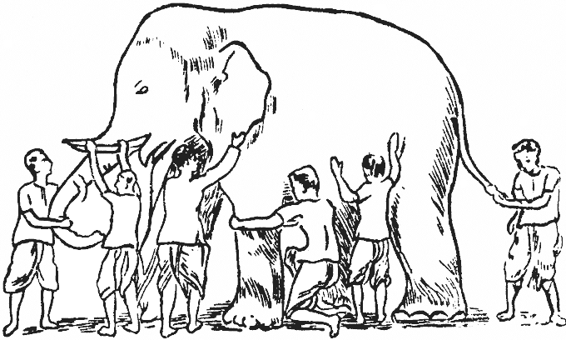
Concurrency

Slide 7

Co-Evolution

Slide 8
The Evolution of C#
C# 4.0
Dynamic Programming
C# 3.0
Language Integrated Query
C# 2.0
Generics
C# 1.0
Managed Code

Slide 9
C# 4.0 Language Innovations
Dynamically Typed Objects
Optional and Named Parameters
Improved COM Interoperability
Co- and Contra-variance

Slide 10





.NET Dynamic Programming
IronPython
IronRuby
C#
VB.NET
Others…
Dynamic Language Runtime
Expression Trees
Dynamic Dispatch
Call Site Caching
Object Binder
JavaScript Binder
Python Binder
Ruby Binder
COM Binder

Slide 11
Dynamically Typed Objects
Calculator calc = GetCalculator();
int sum = calc.Add(10, 20);
object calc = GetCalculator();
Type calcType = calc.GetType();
object res = calcType.InvokeMember("Add",
BindingFlags.InvokeMethod, null,
new object[] { 10, 20 });
int sum = Convert.ToInt32(res);
ScriptObject calc = GetCalculator();
object res = calc.Invoke("Add", 10, 20);
int sum = Convert.ToInt32(res);
Statically typed to be dynamic
dynamic calc = GetCalculator();
int sum = calc.Add(10, 20);
Dynamic conversion
Dynamic method invocation

Slide 12
Dynamically Typed Objects
Compile-time type dynamic
Run-time type System.Int32
dynamic x = 1;
dynamic y = "Hello";
dynamic z = new List<int> { 1, 2, 3 };
When operand(s) are dynamic…
Member selection deferred to run-time
At run-time, actual type(s) substituted for dynamic
Static result type of operation is dynamic

Slide 13
Dynamically Typed Objects
public static class Math
{
public static decimal Abs(decimal value);
public static double Abs(double value);
public static float Abs(float value);
public static int Abs(int value);
public static long Abs(long value);
public static sbyte Abs(sbyte value);
public static short Abs(short value);
...
}
Method chosen at compile-time: double Abs(double x)
double x = 1.75;
double y = Math.Abs(x);
Method chosen at run-time: double Abs(double x)
dynamic x = 1.75;
dynamic y = Math.Abs(x);
Method chosen at run-time: int Abs(int x)
dynamic x = 2;
dynamic y = Math.Abs(x);

Slide 14
Dynamically Typed Objects
demo

Slide 15
IDynamicObject
public abstract class DynamicObject : IDynamicObject
{
public virtual object GetMember(GetMemberBinder info);
public virtual object SetMember(SetMemberBinder info, object value);
public virtual object DeleteMember(DeleteMemberBinder info);
public virtual object UnaryOperation(UnaryOperationBinder info);
public virtual object BinaryOperation(BinaryOperationBinder info, object arg);
public virtual object Convert(ConvertBinder info);
public virtual object Invoke(InvokeBinder info, object[] args);
public virtual object InvokeMember(InvokeMemberBinder info, object[] args);
public virtual object CreateInstance(CreateInstanceBinder info, object[] args);
public virtual object GetIndex(GetIndexBinder info, object[] indices);
public virtual object SetIndex(SetIndexBinder info, object[] indices, object value);
public virtual object DeleteIndex(DeleteIndexBinder info, object[] indices);
public MetaObject IDynamicObject.GetMetaObject();
}

Slide 16
Implementing IDynamicObject
demo

Slide 17
Optional and Named Parameters
Primary method
public StreamReader OpenTextFile(
string path,
Encoding encoding,
bool detectEncoding,
int bufferSize);
Secondary overloads
public StreamReader OpenTextFile(
string path,
Encoding encoding,
bool detectEncoding);
public StreamReader OpenTextFile(
string path,
Encoding encoding);
public StreamReader OpenTextFile(
string path);
Call primary with default values

Slide 18
Optional and Named Parameters
public StreamReader OpenTextFile(
string path,
Encoding encoding,
bool detectEncoding,
int bufferSize);
Optional parameters
public StreamReader OpenTextFile(
string path,
Encoding encoding = null,
bool detectEncoding = true,
int bufferSize = 1024);
Named argument
OpenTextFile("foo.txt", Encoding.UTF8);
OpenTextFile("foo.txt", Encoding.UTF8, bufferSize: 4096);
Named arguments can appear in any order
Arguments evaluated in order written
Named arguments must be last
OpenTextFile(
bufferSize: 4096,
path: "foo.txt",
detectEncoding: false);
Non-optional must be specified

Slide 19
Improved COM Interoperability
object fileName = "Test.docx";
object missing = System.Reflection.Missing.Value;
doc.SaveAs(ref fileName,
ref missing, ref missing, ref missing,
ref missing, ref missing, ref missing,
ref missing, ref missing, ref missing,
ref missing, ref missing, ref missing,
ref missing, ref missing, ref missing);
doc.SaveAs("Test.docx");

Slide 20
Improved COM Interoperability
Automatic object → dynamic mapping
Optional and named parameters
Indexed properties
Optional “ref” modifier
Interop type embedding (“No PIA”)

Slide 21
Improved COM Interoperability
demo

Slide 22
Co- and Contra-variance
.NET arrays are co-variant
string[] strings = GetStringArray();
Process(strings);
void Process(object[] objects) { … }
…but not safely co-variant
void Process(object[] objects) {
objects[0] = "Hello"; // Ok
objects[1] = new Button(); // Exception!
}
Until now, C# generics have been invariant
List<string> strings = GetStringList();
Process(strings);
C# 4.0 supports safe co- and contra-variance
void Process(IEnumerable<object> objects) { … }
void Process(IEnumerable<object> objects) {
// IEnumerable<T> is read-only and
// therefore safely co-variant
}

Slide 23
Safe Co- and Contra-variance
public interface IEnumerable<T>
{
IEnumerator<T> GetEnumerator();
}
public interface IEnumerable<out T>
{
IEnumerator<T> GetEnumerator();
}
out = Co-variant Output positions only
Can be treated as less derived
public interface IEnumerator<T>
{
T Current { get; }
bool MoveNext();
}
public interface IEnumerator<out T>
{
T Current { get; }
bool MoveNext();
}
IEnumerable<string> strings = GetStrings();
IEnumerable<object> objects = strings;
in = Contra-variant Input positions only
public interface IComparer<T>
{
int Compare(T x, T y);
}
public interface IComparer<in T>
{
int Compare(T x, T y);
}
Can be treated as more derived
IComparer<object> objComp = GetComparer();
IComparer<string> strComp = objComp;

Slide 24
Variance in C# 4.0
Supported for interface and delegate types
“Statically checked definition-site variance”
Value types are always invariant
IEnumerable<int> is not IEnumerable<object>
Similar to existing rules for arrays
ref and out parameters need invariant type

Slide 25
Variance in .NET Framework 4.0
Interfaces
System.Collections.Generic.IEnumerable<out T>
System.Collections.Generic.IEnumerator<out T>
System.Linq.IQueryable<out T>
System.Collections.Generic.IComparer<in T>
System.Collections.Generic.IEqualityComparer<in T>
System.IComparable<in T>
Delegates
System.Func<in T, …, out R>
System.Action<in T, …>
System.Predicate<in T>
System.Comparison<in T>
System.EventHandler<in T>

Slide 26
The Evolution of C#
C# 4.0
Dynamic Programming
C# 3.0
Language Integrated Query
C# 2.0
Generics
C# 1.0
Managed Code

Slide 27
Compiler as a Service
Meta-programming
Class
Read-Eval-Print Loop
public
Foo
Language
Object Model
Field
DSL Embedding
private
X
string
Compiler
Compiler
Source File
.NET Assembly
Source code
Source code
Source code
Source code

Slide 28
Compiler as a Service
demo

Slide 29
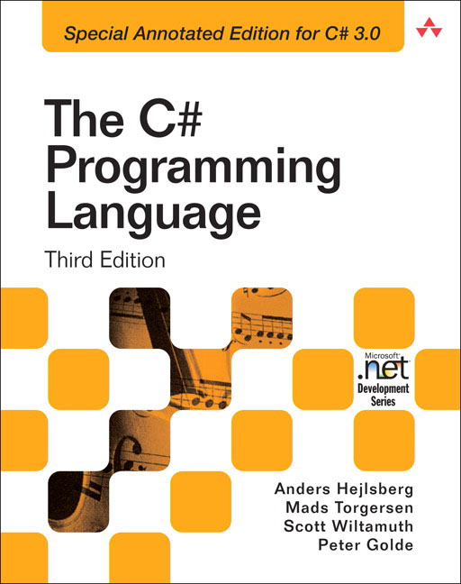
Book Signing
Bookstore
Monday
3:30 PM

Slide 30
Additional Resources
Related Sessions
TL10: Deep Dive: Dynamic Languages in .NET
TL54: Natural Interop with Silverlight, Office, …
TL12: Future Directions for Microsoft Visual Basic
TL57: Panel: The Future of Programming Languages
TL11: An Introduction to Microsoft F#
C# 4.0 Samples and Whitepaper
http://code.msdn.microsoft.com/csharpfuture
Visual C# Developer Center
http://csharp.net

Slide 31



Evals & Recordings
Please fill out your evaluation for this session at:
This session will be available as a recording at:
www.microsoftpdc.com

Slide 32
Please use the microphones provided
Q&A

Slide 33

© 2008 Microsoft Corporation. All rights reserved. Microsoft, Windows, Windows Vista and other product names are or may be registered trademarks and/or trademarks in the U.S. and/or other countries.
The information herein is for informational purposes only and represents the current view of Microsoft Corporation as of the date of this presentation. Because Microsoft must respond to changing market conditions, it should not be interpreted to be a commitment on the part of Microsoft, and Microsoft cannot guarantee the accuracy of any information provided after the date of this presentation. MICROSOFT MAKES NO WARRANTIES, EXPRESS, IMPLIED OR STATUTORY, AS TO THE INFORMATION IN THIS PRESENTATION.

